Slide 1

CHAPTER 3 Process Description and Control
Instructor: Wuman LUO
luowuman@ipm.edu.mo
Office: A213
14:30-17:30 Tuesday & Wednesday

Slide 2
Process
“A program in execution”, also called task
An instance of a program running on a computer
The entity that can be assigned to and executed on a processor
A unit of activity characterized by the execution of a sequence of instructions, a current state, and an associated set of system
What is the difference between program and process?
when the processor begins to execute the program code, we refer to this executing entity as a process

Slide 3

Process Elements
A process is comprised of:
Program code (possibly shared)
A set of data
A process control block

Slide 4
Process Control Block (1/4)
While the program is executing, this process can be uniquely characterized by a number of elements, including:
identifier
state
priority
program counter
memory pointers
context data
I/O status information
accounting information
Notes:
Each process must be represented in some way so the OS can
keep track of it. That is, there must be some information relating to each process, including current state and location in memory; this is the process control block.

Slide 5
Process Control Block (2/4)
Identifier: A unique identifier associated with this process, to distinguish it from all other processes.
State: If the process is currently executing, it is in the running state.
Priority: Priority level relative to other processes.
Program counter: The address of the next instruction in the program to be executed.

Slide 6
Process Control Block (3/4)
Memory pointers: Includes pointers to the program code and data associated with this process, plus any memory blocks shared with other processes.
Context data: These are data that are present in registers in the processor while the process is executing.

Slide 7
Process Control Block (4/4)
I/O status information: Includes outstanding I/O requests, I/O devices (e.g., disk drives) assigned to this process, a list of files in use by the process, and so on.
Accounting information: May include the amount of processor time and clock time used, time limits, account numbers, and so on.

Slide 8

Requirements in Process Management
Interleave the execution of several processes ...
to maximize processor utilization
while providing reasonable response time
Allocate resources to processes
Support interprocess communication
Notes:
The OS must interleave the execution of multiple processes, to maximize processor utilization while providing reasonable response time.
The OS must allocate resources to processes in conformance with a specific policy (e.g., certain functions or applications are of higher priority) while at the same time avoiding deadlock.
The OS may be required to support interprocess communication and user creation of processes, both of which may aid in the structuring of applications.

Slide 9
Process Creation
The life of a process is bounded by its creation and termination
Four common reasons
Submission of a batch job
User logs on
Create to provide a service such as printing
Spawned by an existing process
Notes:
When a new process is to be added to those currently being managed, the OS builds the data structures used to manage the process, and allocates address space in main memory to the process
In a batch environment, a process is created in response to the submission of a job.
In an interactive environment, a process is created when a new user attempts to log on.
In both cases, the OS is responsible for the creation of the new process.
An OS may also create a process on behalf of an application. For example, if a user requests that a file be printed, the OS can create a process that will manage the printing
When the OS creates a process at the explicit request of another process, the action is referred to as process spawning.

Slide 10
Process Termination
Batch job issues Halt instruction
User logs off
Process executes a service request to terminate
Child processes terminate when their parent process terminates
Operating system intervention
E.g. when deadlock occurs
Error and fault conditions
E.g. memory unavailable, protection error, arithmetic error, I/O failure, invalid instruction

Slide 11
Dispatcher
A small program that switches the processor from one process to another
Prevents a single process from monopolizing processor time.
Every process should be able to use the processor for a fair amount of time

Slide 12
Trace of the Process
The behavior of an individual process is shown by listing the sequence of instructions that are executed
This list is called a Trace

Slide 13
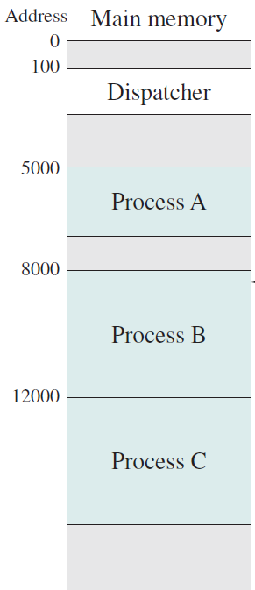
Process Execution
Consider three processes being executed
All are in memory (plus the dispatcher)
Notes:
No use of virtual memory

Slide 14
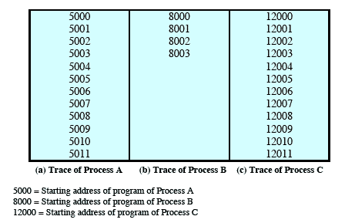
Trace from the Processes Point of View
Each process runs to completion

Slide 15
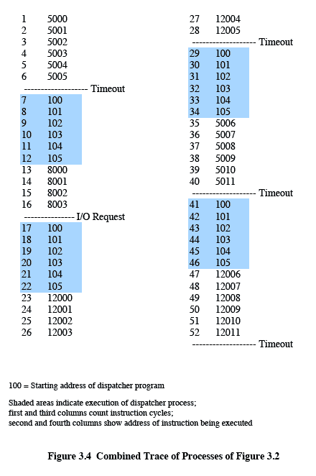
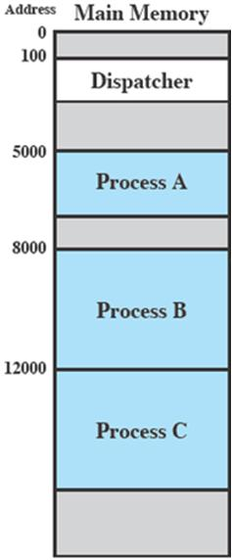
Traces from Processors Point of View
Timeout
Timeout
Timeout
I/O

Slide 16
Round-Robin Scheduling
queue
processor
dispatch
Each process is allowed to execute for at most a quantum.
At timeout, process switching occurs.
Material from Chapter 9
Notes:
Throughput – number of processes that complete their execution per time unit.
Turnaround time – amount of time to execute a particular process.
Waiting time – amount of time a process has been waiting in the ready queue.
Response time – amount of time it takes from when a request was submitted until the first response is produced, not output (for time-sharing environment).

Slide 17
Process is Preempted When…
In the following two cases, a process CANNOT continue running and MUST leave the processor. i.e. it is preempted.
Timeout
I/O, or wait for other events
We’ll learn more cases of process switching later in this chapter.

Slide 18
Two-State Process Model
Dispatch
Enter
Exit
Not
running
Running
Pause
Queue
Enter
Dispatch
Exit
Pause
Notes:
Introduce concept of state diagram, i.e. how to read the diagram
Why two states are not enough? A process is still running but in the state of I/O operation. Hence we cannot ‘kill’ the process (or in the Not-running state) since it is still running the I/O but not the processor

Slide 19
Two States Are Not Enough...
Not-running:
ready to execute
blocked, e.g. waiting for I/O
Dispatcher CANNOT just select the process that has been in the queue the longest (i.e. the one in queue front) because it may be blocked
Running process
Ready process
Blocked process
Notes:
Rather, the dispatcher would have to scan the list looking for the process that is not blocked and that has been in the queue the longest.

Slide 20
Five-State Model
A natural way – split the Not Running state into two states:
Ready and Blocked
Five-state model
Running – being executed by the processor
Ready – ready to execute
Blocked – cannot execute until some event occurs
New – created, but not yet admitted
Exit – released
Notes:
Some event occurs: complete of the I/O reads/writes
New: A process that has just been created but has not yet been admitted to the pool of executable processes by the OS. Typically, a new process has not yet been loaded into main memory, although its process control block has been created.
Exit: A process that has been released from the pool of executable processes by the OS, either because it halted or because it aborted for some reason.

Slide 21
Five-State Process Model
Dispatch
Release
New
Admit
Ready
Running
Exit
Time-out
Event occurs
Event wait
For detail, read explanation on p.139 -142
Blocked
Why no transitions from Ready to Blocked, and Blocked to Running?
Notes:
Running: process currently being executed
Ready: a process is prepared to execute when given the opportunity
Blocked: a process that cannot execute until some event occurs, e.g. the completion of an I/O operation
New: A process that has just been created but has not yet been admitted to the pool of executable processes by the OS. PCB has been created but the process is not loaded into the main memory. For example, a new batch job is submitted for execution. Two steps, 1. creates PCB and required tables; 2. load into main memory when it is ready to run. Note that New and Ready state exist because the processor can only allow a limited number of processes in Ready state.
Exit: A process that has been released from the pool of executable processes by the OS, either because it halted or because it aborted for some reason. Also two steps: 1. a process is terminated due to normal completion. 2. save the tables and other information are preserved for accounting program, e.g. performance analysis.
Null → New: A new process is created to execute a program.
New → Ready: The OS will move a process from the New state to the Ready state when it is prepared to take on an additional process. Most systems set some limit based on the number of existing processes or the amount of virtual memory committed to existing processes. This limit assures there are not so many active processes as to degrade performance.
Ready → Running: When it is time to select a process to run, the OS chooses one of the processes in the Ready state. This is the job of the scheduler or dispatcher. Scheduling is explored in Part Four.
Running → Exit: The currently running process is terminated by the OS if the process indicates that it has completed or if it aborts.
Running → Ready: examples: 1. reaches maximum allowable time 2. preempted process (A is running and B is blocked. While A is still running, B is now ready to run. Since B has higher priority, A is preempted. Or A is a preempted process.
Running → Blocked: 1. request something; it request something other than calculation, e.g. I/O operation that must be completed before going on. Or the running process is requesting data from other process
Blocked → Ready: A process in the Blocked state is moved to the Ready state when the event for which it has been waiting occurs.
Ready/Blocked → Exit: 1. A parent process can terminate a child process at any time. 2. When a parent process terminates, all its associated child processes must also terminate.

Slide 22
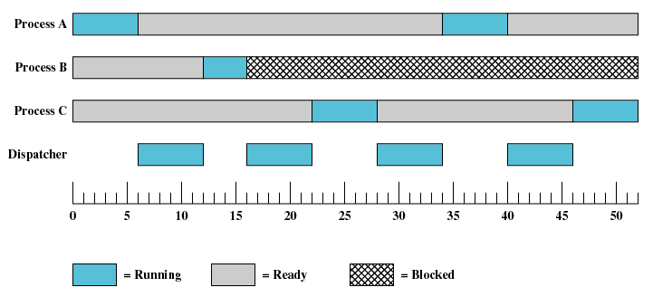
Process States

Slide 23
Blocked Queues
Timeout
Ready queue
Processor
Admit
Dispatch
Release
Event occurs
Blocked queue/ Event queue
Event wait
E1
Running process
Ready process
Blocked process
E2
A separate queue holds the processes waiting for each event.
Notes:
FIFO, no priority scheme
when an event occurs, the OS must scan the entire blocked queue, searching for those processes waiting on that event. In a large OS, there could be hundreds or even thousands of processes in that queue. Therefore, it would be more efficient to have a number of queues, one for each event. Then, when the event occurs, the entire list of processes in the appropriate queue can be moved to the Ready state

Slide 24
How Process State Changes (1/8)
ready
ready
ready
➔
a1. x++ a2. x++ a3. x++ a4. read 8 a5. x++ a6. x++ a7. x++
➔
b1. y++ b2. read 6 b3. y++ b4. y++ b5. y++ b6. y++ b7. y++
➔
c1. z++ c2. z++ c3. z++ c4. z++ c5. z++ c6. z++ c7. z++
Process A
Process B
Process C

Slide 25
How Process State Changes (2/8)
running
ready
ready
➔
a1. x++ a2. x++ a3. x++ a4. read 8 a5. x++ a6. x++ a7. x++
➔
b1. y++ b2. read 6 b3. y++ b4. y++ b5. y++ b6. y++ b7. y++
➔
c1. z++ c2. z++ c3. z++ c4. z++ c5. z++ c6. z++ c7. z++
➔
➔
Process A
Process B
Process C
Timeout

Slide 26
How Process State Changes (3/8)
ready
running
ready
a1. x++ a2. x++ a3. x++ a4. read 8 a5. x++ a6. x++ a7. x++
➔
b1. y++ b2. read 6 b3. y++ b4. y++ b5. y++ b6. y++ b7. y++
➔
c1. z++ c2. z++ c3. z++ c4. z++ c5. z++ c6. z++ c7. z++
➔
➔
Process A
Process B
Process C
Start I/O

Slide 27
How Process State Changes (4/8)
ready
blocked
running
a1. x++ a2. x++ a3. x++ a4. read 8 a5. x++ a6. x++ a7. x++
b1. y++ b2. read 6 b3. y++ b4. y++ b5. y++ b6. y++ b7. y++
➔
c1. z++ c2. z++ c3. z++ c4. z++ c5. z++ c6. z++ c7. z++
zz➔
➔
➔
➔
Process A
Process B
Process C
Timeout

Slide 28
How Process State Changes (5/8)
running
blocked
ready
a1. x++ a2. x++ a3. x++ a4. read 8 a5. x++ a6. x++ a7. x++
b1. y++ b2. read 6 b3. y++ b4. y++ b5. y++ b6. y++ b7. y++
c1. z++ c2. z++ c3. z++ c4. z++ c5. z++ c6. z++ c7. z++
zz➔
➔
➔
Process A
Process B
Process C
Start I/O

Slide 29
How Process State Changes (6/8)
blocked
blocked
running
a1. x++ a2. x++ a3. x++ a4. read 8 a5. x++ a6. x++ a7. x++
b1. y++ b2. read 6 b3. y++ b4. y++ b5. y++ b6. y++ b7. y++
c1. z++ c2. z++ c3. z++ c4. z++ c5. z++ c6. z++ c7. z++
zz➔
zz➔
➔
➔
Process A
Process B
Process C
Suppose process B finishes I/O

Slide 30
How Process State Changes (7/8)
blocked
ready
running
a1. x++ a2. x++ a3. x++ a4. read 8 a5. x++ a6. x++ a7. x++
b1. y++ b2. read 6 b3. y++ b4. y++ b5. y++ b6. y++ b7. y++
c1. z++ c2. z++ c3. z++ c4. z++ c5. z++ c6. z++ c7. z++
➔
zz➔
➔
Process A
Process B
Process C
Timeout

Slide 31
How Process State Changes (8/8)
blocked
running
ready
a1. x++ a2. x++ a3. x++ a4. read 8 a5. x++ a6. x++ a7. x++
b1. y++ b2. read 6 b3. y++ b4. y++ b5. y++ b6. y++ b7. y++
c1. z++ c2. z++ c3. z++ c4. z++ c5. z++ c6. z++ c7. z++
➔
zz➔
➔
➔
➔
Process A
Process B
Process C
Timeout

Slide 32
Priority Scheduling
Each process is assigned a priority
One ready queue for the ready processes of a certain priority
When the OS is going to dispatch a process, it chooses a ready process of the highest priority
When a high priority process becomes ready, it may preempt a running process of lower priority
Note: there are more types of scheduling policies, please refer to Chapter 9.

Slide 33
Priority scheduling, 1
Ready queue for priority 7
Ready queue for priority 6
Each process is assigned a priority. There is one ready queue for the ready processes of a certain priority.
Ready queue for priority 0
Blocked queue

Slide 34
Priority scheduling, 2
Ready queue for priority 7
Ready queue for priority 6
When the OS is going to dispatch a process, it chooses a ready process of the highest priority.
Ready queue for priority 0
Blocked queue

Slide 35
Priority scheduling, 3
The running process A has priority 0.
A
Ready queue for priority 6
When a high priority process becomes ready, it may preempt a running process of lower priority.
Ready queue for priority 0
Process B of priority 6 becomes ready. The OS may preempt the process A and dispatch process B.
Blocked queue
B

Slide 36
Suspend Processes
Processor is so faster than I/O that it will be COMMON for all processes in memory to be waiting for I/O
Even with multiprogramming, a processor could be idle most of the time
What to do?
Expand the memory to accommodate more processes
Cost will be high
Larger memory results in larger processes, NOT more processes
Swapping: moving part or all of a process from main memory to disk when ALL the processes in the memory are in the Blocked state
New state: Suspend
Blocked state becomes suspend state when swapped to disk
Notes:
Recall: no virtual memory, so all the processes have to be loaded in memory.

Slide 37
Suspend States
Ready: The process is in main memory and available for execution.
Blocked: The process is in main memory and awaiting an event.
Blocked/Suspend: The process is in secondary memory and awaiting an event.
Ready/Suspend: The process is in secondary memory but is available for execution as soon as it is loaded into main memory.

Slide 38
State Transition with Suspend States
New
Admit
Admit
Suspend
Activate
Dispatch
Ready / suspend
Ready
Running
Exit
Suspend
Timeout
Release
Event
Occurs
Event
Wait
Event
Occurs
Blocked / suspend
Activate
Blocked
Suspend

Slide 39
An Example
Running
The process starts an I/O operation
Blocked
The process is suspended while waiting for the I/O to finish
Blocked / suspend
I/O is finished
Ready / suspend
The process is activated before I/O is finished
Blocked
The process is activated afterwards
I/O is finished
Ready
Ready

Slide 40
Reasons for Process Suspension
Swapping | The OS needs to release sufficient main memory to bring in a process that is ready to execute.
Other OS reason | The OS may suspend a background or utility process or a process that is suspected of causing a problem.
Interactive user request | A user may wish to suspend execution of a program for purposes of debugging or in connection with the use of a resource.
Timing | A process may be executed periodically (e.g., an accounting or system monitoring process) and may be suspended while waiting for the next time interval.
Parent process request | A parent process may wish to suspend execution of a descendent to examine or modify the suspended process, or to coordinate the activity of various descendants.

Slide 41
Process Image
PCB
OS maintains the following for each process
Process control block (PCB)
User program (.EXE, .DLL, etc)
User data (global and dynamic variables, constant, buffer, …)
User stack (local variables, calling address of procedure)
if (a==100)
b++;
printf(“done”);
“done”
a
b
PCB
PCB
RAM

Slide 42
Process Control Block
PCB contains data that the OS needs to control the process
PCB consists of
Process identification
Processor state information
Process control information
PCB
Process identification
pid:123
uid:tom
Processor state info
eax, ebx, ecx, eflags, eip, cs, ds, ss, …
Process control info
…
…

Slide 43
Process Identification
Process ID, a unique numeric identifier
User identifier
who is responsible for the job, or who runs the process
used to determine what access rights the process has

Slide 44
Processor State Information
Processor state: contents of processor registers, incl.
User-visible registers
Control and status registers, incl. Program Counter, condition codes and status in PSW
Stack pointers (which point to the top of the stack)
Used to save and restore the processor state in process switching

Slide 45
Process Control Information (1/2)
Additional information needed by the operating system to control and coordinate the various active processes
Scheduling and state information, e.g. process state, priority, waiting event, etc.
Data structuring, e.g. for keeping the ready queue as linked list, parent-child relationship

Slide 46
Process Control Information (2/2)
Interprocess communication
Process privileges
Memory management
Resource ownership and utilization, e.g. open files, and a history of utilization of the processor or other resources
Remember to read the detail description on p. 153

Slide 47
Mechanisms for Interrupting Process Execution
Mechanism | Cause | Use
Interrupt | External to the execution of the current instruction | Reaction to an asynchronous external event
Trap | Associated with the execution of the current instruction | Handling of an error or an exceptional condition
Supervisor call | Associated with the execution of the current instruction | Call to an operating system function
Notes:
When to Switch Processes A process switch may occur any time that the OS has gained control from the currently running process. Table above suggests the possible events that may give control to the OS.

Slide 48
When to Switch Processes
Interrupt - interruption request from hardware external to the CPU
Clock
I/O: I/O completion, I/O error
Traps - an error condition or exceptional condition associated with the current instruction
memory fault, detail in chap 7, 8
Supervisor call - call of some special functions of the OS
file open
synchronization primitive, detail in chap 5

Slide 49
Process Switching at Clock Interrupt
Timeout checked in clock interrupt
The OS determines whether the currently running process has been executing for the maximum allowable unit of time, called time slice/quantum. If so, this process must be switched to a Ready state and another process dispatched.

Slide 50
Process Switching at I/O Interrupt
In priority scheduling, if its priority is higher than the running process, it will be dispatched.
When the I/O operation is finished for a blocked process, the process is waken up (moved to Ready state or Ready/Suspend state).
In case of I/O error (interrupt), the blocked process that is waiting for the I/O may be terminated.

Slide 51
Process Switching at Trap
If the error condition caught is fatal (e.g. illegal instruction), the OS moves the process to Exit state. For other traps (e.g. memory fault), the OS may suspend the process and perform some recovery procedure before resuming the process.

Slide 52
Process Switching at Supervisor Call
When a process executes a supervisor call (e.g. for I/O, synchronization), the OS regains control and may move the process to a Blocked state.

Slide 53
Steps of Process Switching (1/2)
Consists of the following steps
Save processor state (incl. program counter and other registers) in the PCB: processor state information
Update the PCB with the new state and any accounting information
Move the PCB to appropriate queue – ready, blocked

Slide 54
Steps of Process Switching (2/2)
Consists of the following steps
Select another process for execution
Update the PCB of the process selected (new state and accounting information)
Update memory-management data structures
Depends on how address translation is managed
Restore context of the selected process
When it was last switched out of the Running state
By loading in the previous value of the program counter and other registers

Slide 55
Steps in Process Switching (1/10)
PCB of process A
PCB of process B
CPU
state
ready
state
ready
AX
xx
AX
0
AX
10
PC
A0
PC
B0
PC
xx
Memory used by A
Memory used by B
➔
A0: mov AX, a A1: inc AX A2: mov a, AX
➔
B0: mov AX, 8 B1: mov b, AX
a
2
b
99
a++
b = 8

Slide 56
Steps in Process Switching (2/10)
PCB of process A
PCB of process B
CPU
state
running
5
state
ready
AX
0
AX
0
AX
10
7
PC
A0
PC
B0
PC
A0
Memory used by A
Memory used by B
➔
A0: mov AX, a A1: inc AX A2: mov a, AX
➔
B0: mov AX, 8 B1: mov b, AX
a
2
b
99
Process A is dispatched. PCB of A is updated, and the processor state information is copied to the CPU.

Slide 57
Steps in Process Switching (3/10)
PCB of process A
PCB of process B
CPU
state
running
state
ready
AX
2
AX
0
AX
10
PC
A0
PC
B0
PC
A1
Memory used by A
Memory used by B
A0: mov AX, a A1: inc AX A2: mov a, AX
➔
B0: mov AX, 8 B1: mov b, AX
➔
a
2
b
99
After executing A0

Slide 58
Steps in Process Switching (4/10)
PCB of process A
PCB of process B
CPU
state
running
state
ready
AX
3
AX
0
AX
10
PC
A0
PC
B0
PC
A2
Memory used by A
Memory used by B
A0: mov AX, a A1: inc AX A2: mov a, AX
➔
B0: mov AX, 8 B1: mov b, AX
➔
a
2
b
99
After executing A1

Slide 59
Steps in Process Switching (5/10)
PCB of process A
PCB of process B
CPU
state
ready
1
state
ready
AX
3
AX
3
AX
10
PC
A2
2
PC
B0
PC
A2
3
Memory used by A
Memory used by B
4
A0: mov AX, a A1: inc AX A2: mov a, AX
➔
B0: mov AX, 8 B1: mov b, AX
➔
a
2
b
99
Timeout for Process A, which state changes from running to ready. PCB of A is updated, and the processor state information is copied from the CPU.

Slide 60
Steps in Process Switching (6/10)
PCB of process A
PCB of process B
CPU
state
ready
state
running
5
AX
10
AX
3
AX
10
7
PC
A2
PC
B0
PC
B0
Memory used by A
Memory used by B
A0: mov AX, a A1: inc AX A2: mov a, AX
➔
B0: mov AX, 8 B1: mov b, AX
➔
a
2
b
99
Process B is dispatched. PCB of B is updated, and the processor state information is copied to the CPU.

Slide 61
Steps in Process Switching (7/10)
PCB of process A
PCB of process B
CPU
state
ready
state
running
AX
8
AX
3
AX
10
PC
A2
PC
B0
PC
B2
Memory used by A
Memory used by B
A0: mov AX, a A1: inc AX A2: mov a, AX
B0: mov AX, 8 B1: mov b, AX
➔
➔
a
2
b
8
After executing B0 and B1

Slide 62
Steps in Process Switching (8/10)
PCB of process A
PCB of process B
CPU
state
ready
state
ready
1
AX
8
AX
3
AX
8
PC
A2
PC
B2
2
PC
B2
3
Memory used by A
Memory used by B
4
A0: mov AX, a A1: inc AX A2: mov a, AX
B0: mov AX, 8 B1: mov b, AX
➔
➔
a
2
b
8
Timeout for Process B, which state changes from running to ready. PCB of B is updated, and the processor state information is copied from the CPU.

Slide 63
Steps in Process Switching (9/10)
PCB of process A
PCB of process B
CPU
state
running
5
state
ready
AX
3
AX
3
AX
8
7
PC
A2
PC
B2
PC
A2
Memory used by A
Memory used by B
A0: mov AX, a A1: inc AX A2: mov a, AX
B0: mov AX, 8 B1: mov b, AX
➔
➔
a
2
b
8
Process A is dispatched. PCB of A is updated, and the processor state information is copied to the CPU.

Slide 64
Steps in Process Switching (10/10)
PCB of process A
PCB of process B
CPU
state
running
state
ready
AX
3
AX
3
AX
8
PC
A2
PC
B2
PC
A3
Memory used by A
Memory used by B
A0: mov AX, a A1: inc AX A2: mov a, AX
B0: mov AX, 8 B1: mov b, AX
➔
➔
a
3
b
8
After executing A2

Slide 65
Conclusion
What is a process?
Process state (5 state model, 7 state model)
Process scheduling (round-robin, priority)
Process Image and PCB
Process switching (when, how)

Slide 66

Next Topic
Threads and SMP
Read Ch. 4

